Slide 1
Visual Analysis

Slide 2
Sample Agenda Slide
1
Introducing Visual Analysis
The Perfecto interface
2
3
Scrolling
4
Hands on practice

Slide 3
Introducing Visual Analysis

Slide 4
What is visual analysis?
We have used object locators in our tests. These locators rely on the XHTML code which the app renders into a visual user interface.
Visual Analysis takes a screenshot image from a device and analyzes it for text (Optical Character Recognition) and images (Image Recognition).
When should I use it?
When object analysis is not available for the required element or is becoming difficult to maintain for a specific element
When you want to validate what the user actually sees
Verify layout of the application, landscape vs portrait for instance
Visual analysis complements the object based testing. Recommended to use sparingly to increase coverage and validation value.

Slide 5
What can we do with visual analysis?
Similar to objects, the functionality if first to find if a text or image appears on the screen
The string or image we are looking for is called the needle, the device screen is the haystack
Once the object is found we can perform standard actions
Click
Send text
Get text

Slide 6
Robustness – Text analysis
Perfecto uses OCR to analyze the text on the device screen. This technology is not 100% accurate but in most cases text analysis is quite stable
It is possible to define advanced criteria e.g. multiple strings, starts with, ends with etc.
Longer strings are more reliable
Text analysis can be used across multiple devices & platforms
Let’s take a peek at the visual analysis parameters
https://help.perfecto.io/perfecto-help/content/perfecto/automation-testing/general_visual_analysis_parameters.htm
The main parameters are
Timeout
Language
Index
match

Slide 7
Robustness – image analysis
Perfecto uses bitmap comparison to analyse the image on the device screen. This technology is 100% accurate but does not carry well across different screens.
Images require downloading a screenshot and cropping it
It may be necessary to maintain an image per device model
Image analysis is not recommended

Slide 8
The Perfecto Interface

Slide 9
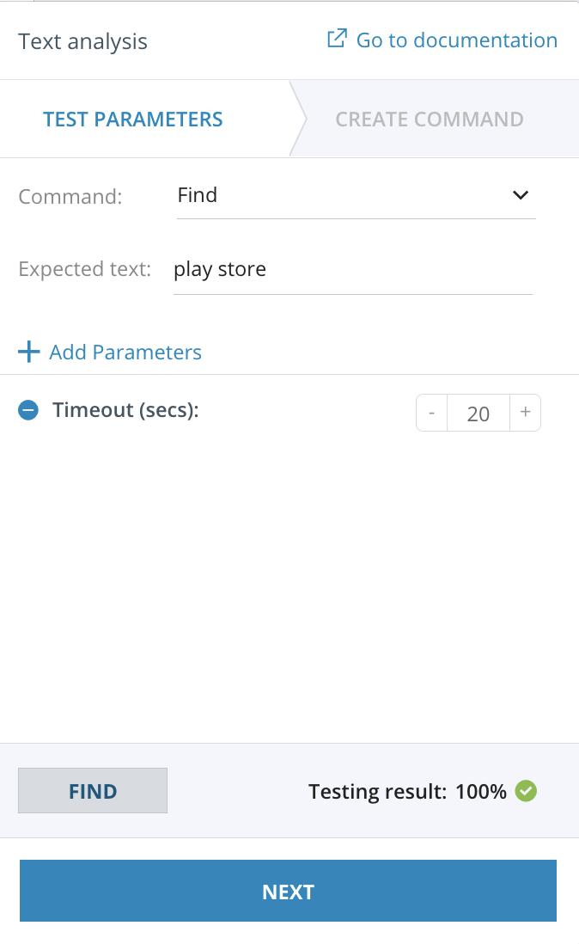
Visual Analysis interface
Perfecto provides widgets to assist in defining the visual analysis commands.
There are separate widgets for text & image.
The widgets allow defining & testing parameters
Full text analysis availabe
Image analysis requires manual provision of the image searched for
Login to manual testing and we will open the widgets together

Slide 10
Scrolling

Slide 11
Scrolling
When the needle is not found, the system can perform the following actions
Exit with a failure
Wait for the needle to appear - the timeout parameter
Scroll the screen in an attempt to find the needle
When scrolling is enabled, the system will perform the following actions
Search for the needle
Fail
Perform scroll operation
Search for needle
Fail again
Perform scroll operation

Slide 12
Scrolling continued
The scroll operations requires 3 parameters
Scroll – turn the scrolling option on or off (off by default)
Next – define the scroll operation to perform
SWIPE_UP | SWIPE_DOWN | SWIPE_RIGHT | SWIPE_LEFT | UP | DOWN | RIGHT | LEFT
Custom operations can also be defined - https://help.perfecto.io/perfecto-help/content/perfecto/automation-testing/create_custom_swipe_gestures.htm
maxscroll – the number of times to scroll before exiting the command (default 5)
In many cases, visual analysis with scroll is used in order to just perform the scroll action

Slide 13
Hands on practice

Slide 14
Visual analysis in your test cases
Let’s add visual analysis to your test case
Add visual validations to the tests
Add scrolling if necessary

Slide 15
THANK YOU

